Slide 1
HIBERNATE
Object Relational Mapping Tool
For Java Environment

Slide 2
Introductions
Who is everybody?
  Background
  Previous experience (Spring-JDBC, JDO, ORM tools)
  Any interesting projects you’re working on.

Slide 3
Object/Relational Persistence and ORM
Persistent data in modern object-oriented applications & efficient data management

Slide 4
What is persistence?
In object-oriented applications:
“Persistence”
  where data (state) outlives the process that created it
“Transient”
  objects in a system are by default transient
We need a data model and data store for persistent data...
The Relational Data Model and
SQL-based Database Management Systems.

Slide 5
What is persistence?
PERSISTENCE APPROACHES
1. A well-know and widely used DAO design pattern to wide complex
JDBC code and no portable SQL from business logic.
ORM also uses DAO pattern
2. IBatis is a best persistence layer for legacy systems, Batch processing system and Report generation.
JDBC, Spring-JDBC and IBatis(SQL Maps)

Slide 6
What is persistence?
PERSISTENCE APPROACHES
3. EJB entity beans (CMP)
Not fully object-oriented
Not portable across application servers
Need to use DTO(Data transfer object or Value
objects), and additional load
Persistence runs only with EJB container
Problems for Test Cases
In EJB3 no CMP, uses ORM for persistence
Hibernate is good for JBOSS and major app. Servers
Top Link is good for Oracle app. server

Slide 7
What is persistence?
PERSISTENCE APPROACHES
4. Object-oriented database system (ODBMS)
JDO (Java Data Objects) are popular.
But, object-databases are not widely adopted.
5. XML Parses
Advantages over Serialization but it is just another text file format.

Slide 8
What is persistence?
PERSISTENCE APPROACHE
6. THE BEST FOR THE MOST PROBLEMS
ORM (Object-Relation Model)
An API for performing basic CRUD operations on objects of persistent classes
A language or API for specifying queries that refer to classes and properties of classes
A facility for specifying mapping metadata
A technique for the ORM implementation to interact with transactional objects to perform lazy association fetching and other optimization functions.

Slide 9
What is persistence?
PERSISTENCE APPROACHE
6. THE BEST FOR THE MOST PROBLEMS
ORM (Object-Relation Model)
ORM advantages:
Productivity - no tedious SQL code
Maintainability - Fewer lines of code makes the system more understandable
Performance

Slide 10
The persistence layer
How does the Java application interact with the SQL database?
Application layers
  group related code by concern
  prevent leakage of concerns
  have clear interfaces to avoid inter-layer dependencies
A typical Layered Architecture and its interface dependencies:
Presentation Layer
Utility
and
Helper
Classes
Business Layer
Persistence Layer

Slide 11
Layered Architecture
Presentation
Bussiness
Integration
Action
Servlet
DAO
Action
Bussiness
Interface
Bussiness
Imple
DAO
Interface
3.Delegate
1.Request
Action
Action
Browser
DAO
Implement
5.Forward
2. Populate
ActionForm
Response
JSP
ActionForm
Database/
Services
ActionForm
View

Slide 12
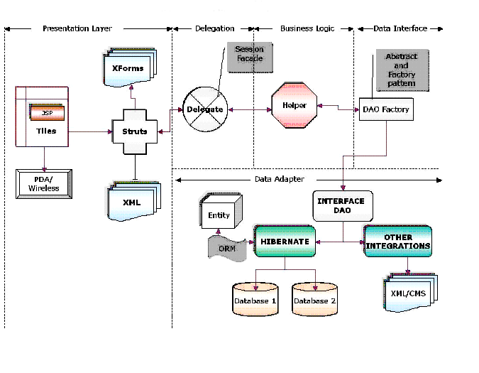
Layered Architecture

Slide 13
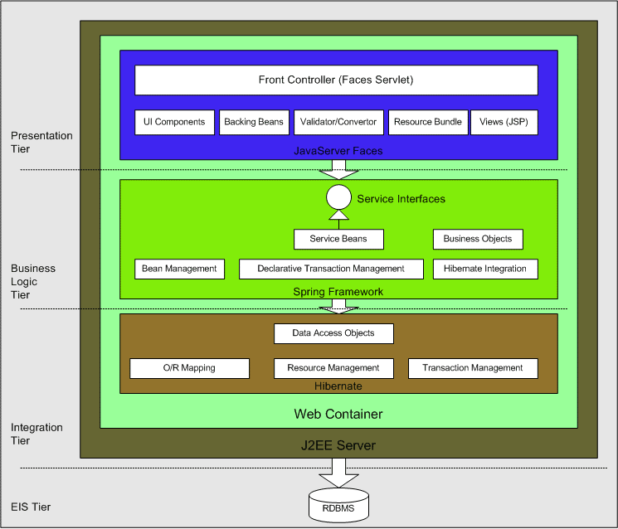
Layered Architecture

Slide 14
Tabular Data vs. Domain Model
Some applications work exclusively with a tabular representation of persistent data:
  application works with tabular result sets in all layers
  straightforward with JDBC and SQL
  even better with detached RowSet (JSR 114)
  hard to code re-usable business logic
Other applications have an object-oriented domain model:
  significant business logic, benefits from object-oriented techniques such as inheritance, polymorphism, and patterns
  greater degree of abstraction of the underlying relational data
  SQL / JDBC no longer so appropriate
  certain operations (batch processing, reporting) are more tabular in nature
Some applications benefit from both, in different places.

Slide 15
Domain Model and the paradigm mismatch
Classes implement the business entities of our domain model
  attributes of the entity are properties of our Java class
  associations between entities are also implemented with properties
Let’s see if there is a problem mapping this to tables and columns...
User
BillingDetails
userName: String
address: String
billingDetails: Set
1
1..*
accountNumber: String
accountName: String
accountType: String
user: User

Slide 16
Creating tables for the Domain Model
SQL schema design for trivial cases is ... trivial:
We’ll see the 5 problems of the O/R paradigm mismatch appear as we gradually make our model more complex…
create table USER (
USER_NAME varchar not null primary key,
ADDRESS varchar not null)
create table BILLING_DETAILS (
ACCOUNT_NUMBER varchar not null primary key,
ACCOUNT_NAME varchar not null,
ACCOUNT_TYPE varchar not null,
USER_NAME varchar foreign key references USER)
Notes:
trivial - Of little substance or significance

Slide 17
The problem of granularity
  should we create a new ADDRESS table?
  should we create a new SQL data type and change the column?
  user-defined data types (UDT) are not portable and the standard is weak
We usually add new columns to USER with built-in SQL data types:
Address
User
userName: String
billingDetails: Set
street: String
city: String
zipcode: String
create table USER (
USER_NAME varchar not null primary key,
ADDRESS_STREET varchar not null,
ADDRESS_CITY varchar not null,
ADDRESS_ZIPCODE varchar not null)

Slide 18
The problem of subtypes
We create subclasses of BillingDetails:
and use polymorphism in Java to implement our billing strategy.
How do we represent subtypes in our relational model?
SQL databases don’t provide inheritance and lack of polymorphic association. A standard foreign key constraint refers to exactly one table; it isn’t straightforward to define a foreign key that refers to mulitple tables.
1
1..*
User
BillingDetails
CreditCard
Cheque

Slide 19
The problem of identity
In Java, we have two notions of "sameness“
  object identity is the memory location of an object, a==b
  B. object equality (what is this really?), a.equals(b)
In SQL databases, we identify a particular row using the primary key and the table name. Often, this is a (meaningless) surrogate key!

Slide 20
The problem of associations
Object-oriented languages represent entity relationships as
  object references (pointers) and collections of object references
Relational databases represent entity relationships as
  copies of primary key values
  referential integrity ensured by foreign key constraints
The mismatch:
  object references are directional, there is no such concept in the relational model
  many-to-many associations require a link table in relational databases

Slide 21
The problem of object graph navigation
In Java, we "walk" the object graph by following references:
  david.getBillingDetails().getAccountName()
In SQL, we join tables to get the required data:
  select * from USER u
  left outer join BILLING_DETAILS bd
  on bd.USER_ID = u.USER_ID
  where u.USERNAME = “david"
Avoid the n+1 selects problem by minimizing the SQL
required for graph walking!

Slide 22
The cost of the mismatch
There problems can, at least theoretically, be solved using handwritten SQL/JDBC
  by writing a lot of tedious code (maybe 30% of your codebase)
  The “mismatch problem” is real
  better UDT support in SQL will not solve all the issues
  not all applications are suitable for table-oriented approaches
Is the solution design patterns (DAO)
or programming models (EJB entity beans)?
"How should we implement the persistence layer in our application?"
Notes:
UDL – User Defined Type

Slide 23
Object/Relational Mapping
Object / Relational Mapping (ORM)
  solve the mismatch problem in middleware
  an ORM solution transforms data from the object-oriented representation to the relational representation
  metadata governs this transformation
Elements of an ORM implementation
  a programming model for the domain objects
  an API for performing CRUD operations
  a query language or other query facility
  a metadata facility

Slide 24
JDBC Vs Hibernate
JDBC allows developers to connect, query and update a database using the Structured Query Language.
JDBC API standard provides Java developers to interact with different RDBMS and access table data through Java application without learning RDBMS details and using Database Specific JDBC Drivers.
JDBC Architecture
JDBC makes the interaction with RDBMS simple and intuitive. When a Java application needs to access database:
    • open connection to database,
    • use JDBC driver to send SQL queries to database,
    • process the results that are returned, and
    • close the connection.

Slide 25
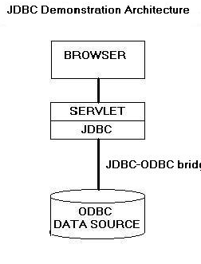
JDBC Vs Hibernate
JDBC uses two architectures to communicate with database:
  1) The driver connects to database and executes SQL statements. Results are sent back from driver to driver manager and finally to the application.
  2) The JDBC driver communicates with ODBC driver. ODBC driver executes SQL query and then results are sent back to JDBC driver to driver manager and then to application.

Slide 26
JDBC Vs Hibernate
General steps:
  1) Load the RDBMS specific JDBC driver because this driver actually communicates with the database.
  2) Open the connection to database which is then used to send SQL statements and get results back.
  3) Create JDBC Statement object. This object contains SQL query.
  4) Execute statement which returns resultset(s). ResultSet contains the tuples of database table as a result of SQL query.
  5) Process the result set.
  6) Close the connection.
Example: Retrieve list of employees from Employee table using JDBC.
String url = “jdbc:odbc:” + dbName;
List<EmployeeBean> employeeList = new ArrayList<EmployeeBean>();
/* load the jdbc-odbc driver */
class.forName(“sun.jdbc.odbc.JdbcOdbcDriver”);
/* Open a connection to database */
Connection con = DriverManager.getConnection(url);
/* create Statement object */
Statement stmt = con.createStatement();
/* execute statement */
ResultSet rs = stmt.executeQuery("SELECT * FROM Sells");
while ( rs.next() )
{
EmployeeBean eb = new Employeebean();
eb.setName(rs.getString("name"));
eb.setSalary(rs.getFloat("salary"));
employeeList.add(eb);

Slide 27
JDBC Vs Hibernate
Hibernate is an Object-Relational Mapping (ORM) solution for JAVA. It is a powerful, high performance object/relational persistence and query service.
It allows us to develop persistent classes following object-oriented idiom – including association, inheritance and polymorphism.

Slide 28
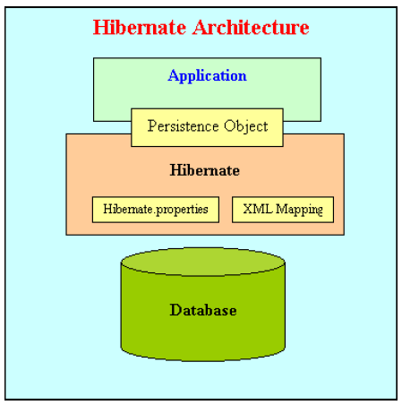
JDBC Vs Hibernate
Hibernate Architecture Hibernate:
1) itself opens connection to database,
2) converts HQL (Hibernate Query Language) statements to database specific statement,
3) receives result set,
4) then performs mapping of these database specific data to Java objects which are directly used by Java application.
Hibernate uses the database specification from Hibernate Properties file.
Automatic mapping is performed on the basis of the properties defined in hbm XML file defined for particular Java object.

Slide 29
JDBC Vs Hibernate
General steps:
  1. Load the Hibernate configuration file and create configuration object. It will automatically load all hbm mapping files.
  2. Create session factory from configuration object
  3. Get one session from this session factory.
  4. Create HQL query.
  5. Execute query to get list containing Java objects.
Example: Retrieve list of employees from Employee table using Hibernate.
/* Load the hibernate configuration file */
Configuration cfg = new Configuration();
cfg.configure(CONFIG_FILE_LOCATION);
/* Create the session factory */
SessionFactory sessionFactory = cfg.buildSessionFactory();
/* Retrieve the session */
Session session = sessionFactory.openSession();
/* create query */
Query query = session.createQuery("from EmployeeBean”);
/* execute query and get result in form of Java objects */
List<EmployeeBean> finalList = query.list();

Slide 30
JDBC Vs Hibernate
EmployeeBean.hbm.xml File
<?xml version="1.0" encoding="utf-8" ?>
<!DOCTYPE hibernate-mapping PUBLIC
"-//Hibernate/Hibernate Mapping DTD 3.0//EN"
"http://hibernate.sourceforge.net/hibernate-mapping-3.0.dtd">
<hibernate-mapping>
<class name="com.mf.bean.EmployeeBean"
table="t_employee">
<id name="id" type="string" unsaved-value="null">
<column name="id" sql-type="varchar(32)" not-null="true"/>
<generator class="uuid"/>
</id>
<property name="name">
<column name="name" />
</property>
<property name="salary">
<column name="salary" />
</property>
</class>
</hibernate-mapping>

Slide 31
JDBC Vs Hibernate
1) Relational Persistence for JAVA
Working with both Object-Oriented software and Relational Database is complicated task with JDBC because there is mismatch between how data is represented in objects versus relational database.
So with JDBC, developer has to write code to map an object model's data representation to a relational data model and its corresponding database schema.
Hibernate is flexible and powerful ORM solution to map Java classes to database tables.
Hibernate itself takes care of this mapping using XML files so developer does not need to write code for this.

Slide 32
JDBC Vs Hibernate
2) Transparent Persistence
The automatic mapping of Java objects with database tables and vice versa is called Transparent Persistence.
Hibernate provides transparent persistence and developer does not need to write code explicitly to map database tables tuples to application objects during interaction with RDBMS.
With JDBC this conversion is to be taken care of by the developer manually with lines of code.

Slide 33
JDBC Vs Hibernate
3) Support for Query Language
JDBC supports only native Structured Query Language (SQL). Developer has to find out the efficient way to access database, i.e to select effective query from a number of queries to perform same task.
Hibernate provides a powerful query language Hibernate Query Language (independent from type of database) that is expressed in a familiar SQL like syntax and includes full support for polymorphic queries.
Hibernate also supports native SQL statements. It also selects an effective way to perform a database manipulation task for an application.

Slide 34
JDBC Vs Hibernate
4) Database Dependent Code Application using JDBC to handle persistent data (database tables) having database specific code in large amount.
The code written to map table data to application objects and vice versa is actually to map table fields to object properties.
As table changed or database changed then it’s essential to change object structure as well as to change code written to map table-to-object/object-to-table.
Hibernate provides this mapping itself.
The actual mapping between tables and application objects is done in XML files.
If there is change in Database or in any table then the only need to change XML file properties.

Slide 35
JDBC Vs Hibernate
5) Maintenance Cost
With JDBC, it is developer’s responsibility to handle JDBC result set and convert it to Java objects through code to use this persistent data in application.
So with JDBC, mapping between Java objects and database tables is done manually.
Hibernate reduces lines of code by maintaining object-table mapping itself and returns result to application in form of Java objects. It relieves programmer from manual handling of persistent data, hence reducing the development time and maintenance cost.

Slide 36
JDBC Vs Hibernate
6) Optimize Performance
Caching is retention of data, usually in application to reduce disk access.
Hibernate, with Transparent Persistence, cache is set to application work space.
Relational tuples are moved to this cache as a result of query.
It improves performance if client application reads same data many times for same write.
Automatic Transparent Persistence allows the developer to concentrate more on business logic rather than this application code. With JDBC, caching is maintained by hand-coding.

Slide 37
JDBC Vs Hibernate
7) Automatic Versioning and Time Stamping
By database versioning one can be assured that the changes done by one person is not being roll backed by another one unintentionally.
Hibernate enables developer to define version type field to application, due to this defined field Hibernate updates version field of database table every time relational tuple is updated in form of Java class object to that table.
So if two users retrieve same tuple and then modify it and one user save this modified tuple to database, version is automatically updated for this tuple by Hibernate. When other user tries to save updated tuple to database then it does not allow to save it because this user does not has updated data.
In JDBC there is no check that always every user has updated data. This check has to be added by the developer.

Slide 38
JDBC Vs Hibernate
8) Open-Source, Zero-Cost Product License
Hibernate is an open source and free to use for both development and production deployments.

Slide 39
Disadvantages of Hibernate
Disadvantages of Hibernate
1) Use of Hibernate is an overhead for the applications which are :
• simple and use one database that never change
• need to put data to database tables, no further SQL queries
• there are no objects which are mapped to two different tables
Hibernate increases extra layers and complexity. So for these types of applications JDBC is the best choice.
2) Anybody wanting to maintain application using Hibernate will need to know Hibernate.

Slide 40
Disadvantages of Hibernate
Disadvantages of Hibernate
3) For complex data, mapping from Object-to-tables and vise versa reduces performance and increases time of conversion.
4) Hibernate does not allow some type of queries which are supported by JDBC. For example It does not allow to insert multiple objects (persistent data) to same table using single query. Developer has to write separate query to insert each object.

